Slide 1


Mae Ezra T. Abundo
September 2, 2025

Slide 2

Outline
Executive Summary
Introduction
Methodology
Results
Conclusion
Appendix

Slide 3
Executive Summary
This project followed a comprehensive data science pipeline to predict the success of Falcon 9 first-stage landings.
Summary of methodologies
Data Collection: Collected SpaceX launch data from Wikipedia and the SpaceX API.
Data Wrangling & EDA: Cleaned and prepped data. Used Folium to visualize launch sites and Dash/Plotly to build an interactive dashboard.
Machine Learning: Developed a model to predict successful first-stage landings.
Summary of all results
Findings: Discovered correlations between launch success and factors like payload mass and launch site.
Best Model: The K-Nearest Neighbors model was identified as the best performer for predicting landing success.
Tool: The interactive Dash dashboard allows users to explore launch success rates based on launch site and payload mass.

Slide 4
Introduction
SpaceX has revolutionized the aerospace industry by pioneering reusable rocket technology, significantly reducing the cost of space travel. The Falcon 9 rocket, in particular, is a game-changer because its first stage can be recovered after a mission, allowing for a much lower price per launch compared to competitors who use expendable rockets. Predicting the success of these landings is therefore a critical task, as it directly impacts the financial viability and reliability of future missions. This project leverages publicly available data to analyze and model the factors influencing a successful landing.
The primary objective of this project is to build a predictive model that can accurately determine whether a Falcon 9 first stage will land successfully. To achieve this, we will explore several key questions:
How do different variables, such as payload mass, launch site, and orbit, affect the success rate of a landing?
Have the success rates of Falcon 9 landings improved over time as the company has gained more experience and refined its technology?
Which machine learning algorithm is best suited for this binary classification problem?

Slide 5

Section 1

Slide 6
Methodology
Executive Summary
Data collection methodology:
Describe how data was collected
Perform data wrangling
Describe how data was processed
Perform exploratory data analysis (EDA) using visualization and SQL
Perform interactive visual analytics using Folium and Plotly Dash
Perform predictive analysis using classification models
How to build, tune, evaluate classification models

Slide 7
Data Collection
The data sets were collected using RESTful API calls to the SpaceX public API endpoints. The collection process involved systematic retrieval of rocket launch data, mission information, and spacecraft details through structured HTTP requests.
Key Phases:
API Endpoint Identification - Identified SpaceX API endpoints for launch and rocket data
Data Retrieval Implementation - Implemented HTTP GET requests using Python requests library
Data Processing and Storage - Parsed JSON responses and structured into pandas DataFrames and applied data validation and cleaning procedures

Slide 8
Data Collection – SpaceX API
GitHub URL: https://github.com/maeezra/IBMCapstoneProject/blob/cac3f74ad288f1075f0ecf0bad4fe0ac9eac4613/jupyter-labs-spacex-data-collection-api.ipynb
Data Collection flowchart
[Start] → [Initialize API Connection] → [Send GET Request to SpaceX API]
↓
[Receive JSON Response] → [Parse JSON Data] → [Validate Data Quality]
↓
[Store in DataFrame] → [End: Apply Data Cleaning]

Slide 9
Data Collection - Scraping
The collection process involved systematic retrieval of launch data, mission information, and spacecraft details through structured HTML parsing.
Key Phases:
Target Identification, Data Extraction Implementation, Data Processing and Storage
GitHub URL: https://github.com/maeezra/IBMCapstoneProject/blob/6f82722c46ba82dc2117fbfd8d285b06ec19c62b/jupyter-labs-webscraping.ipynb
Web Scraping flowchart
[Start] → [Initialize Web Scraping Environment] → [Send GET Request to Wikipedia URL] ↓ [Receive HTML Response] → [Parse HTML with BeautifulSoup] → [Locate Launch Data Tables] ↓ [Extract Table Headers] → [Parse Table Rows and Cells] → [Apply Data Cleaning Functions] ↓ [Store in DataFrame] → [End: Validate Data Quality]

Slide 10
Data Wrangling
The wrangling process involved comprehensive analysis of launch outcomes, mission parameters, and booster recovery data to create a machine learning-ready dataset.
Key Phases:
Data Quality Assessment - Identified missing values in dataset and performed data type analysis.
Exploratory Data Analysis Implementation - Applied pandas value_counts() methodology to analyze launch site distribution and orbit type frequencies excluding transfer orbits.
Landing Outcome Standardization - Transformed complex categorical outcomes into binary classification labels using conditional logic and set operations.
GitHub URL: https://github.com/maeezra/IBMCapstoneProject/blob/8b0dd4eb278f5519b3178ca41bbbe9b9e84ccecb/labs-jupyter-spacex-Data%20wrangling.ipynb

Slide 11
EDA with Data Visualization
Flight Number & Payload Mass
Chart Used: Categorical Scatter Plot. This chart was used to explore the relationship between a launch's flight number, its payload mass, and the landing outcome.
Launch Site Analysis
Chart Used: Bar Chart. A bar chart was used to summarize and compare the number of launches from different launch sites.
Performance Over Time
Chart Used: Line Chart. A line chart was used to visualize trends over a continuous period, such as the success rate over time.
GitHub URL: https://github.com/maeezra/IBMCapstoneProject/blob/1c8c51412f1c051adc0179ce652b2d4f1f99c32f/edadataviz.ipynb

Slide 12
EDA with SQL
Launch site analysis - Identified 4 unique SpaceX launch locations using DISTINCT queries
Payload calculations - Computed total (45,596 kg) and average (2,928.4 kg) payload masses by customer and booster version
Landing outcomes - Found first successful ground landing (Dec 22, 2015) and analyzed drone ship success rates
Mission performance - Counted 98 successful vs 1 failed mission, identified boosters with maximum payload capacity
Temporal patterns - Examined 2015 failure trends and ranked landing outcomes by frequency (2010-2017)
Data filtering - Applied pattern matching, date ranges, and subqueries to extract specific mission characteristics
GitHub URL: https://github.com/maeezra/IBMCapstoneProject/blob/105937e9506f4d6d47f9c59d4f291a0c7b3f761e/jupyter-labs-eda-sql-coursera_sqllite.ipynb

Slide 13
Build an Interactive Map with Folium
The following objects were created and added to the Folium map:
folium.Map: The base map was created, initially centered on the NASA Johnson Space Center.
folium.Circle: A blue circle with a 1000-meter radius was added for the NASA Johnson Space Center and circles were added for each launch site to visualize their locations.
folium.Marker: Markers with DivIcon were created for the NASA Johnson Space Center and each launch site to pinpoint their locations and provide a text label of their names.
These were added to:
Visually represent the locations of SpaceX launch sites and related infrastructure in an interactive manner.
Allow for the calculation of distances between launch sites and other points of interest.
Provide a visual context for analyzing the proximity of launch sites to the coast and cities.
GitHub URL: https://github.com/maeezra/IBMCapstoneProject/blob/30cc9d34784718483507415386e3b3f140ac9572/lab_jupyter_launch_site_location.ipynb

Slide 14
Build a Dashboard with Plotly Dash
These are the components added in the dashboard:
Launch Site Dropdown + Payload Range Slider for filtering data
Pie Chart: Success rates by site (overview) or success/failure ratio (specific site)
Scatter Plot: Payload mass vs. launch success, color-coded by booster version
These components were added for:
Mission Planning: Compare site performance to select optimal launch location
Risk Assessment: Analyze payload weight limits and success probability correlations
Performance Tracking: Visualize technology improvements and historical trends across sites
Interactive Analysis: Enable multi-dimensional filtering for complex mission requirement scenarios
GitHub URL: https://github.com/maeezra/IBMCapstoneProject/blob/6318e193306bbae5da1047485a052512b8b2eb5f/spacex-dash-app.py

Slide 15
Predictive Analysis (Classification)
To predict whether the first stage of a Falcon 9 rocket would land, a machine learning model was developed and evaluated using the following steps:
Data Preparation: The dataset was split into training and testing sets, with 18 samples reserved for testing.
Model Building and Tuning: Three classification models were created: Logistic Regression, Support Vector Machine (SVM), and a Decision Tree. Each model's hyperparameters were optimized using GridSearchCV.
Model Evaluation: The accuracy of each model was calculated using the test data. Their performance was also visualized with a confusion matrix.
Best Model Selection: The final step involved comparing the accuracy scores of all models to find the one that performed best.
GitHub URL: https://github.com/maeezra/IBMCapstoneProject/blob/a1e2be3d909d33f6a5b829dbe84de4d885c55fa1/SpaceX_Machine%20Learning%20Prediction_Part_5.ipynb

Slide 16
Results
Exploratory data analysis results
Interactive analytics demo in screenshots
Predictive analysis results

Slide 17

Section 2

Slide 18
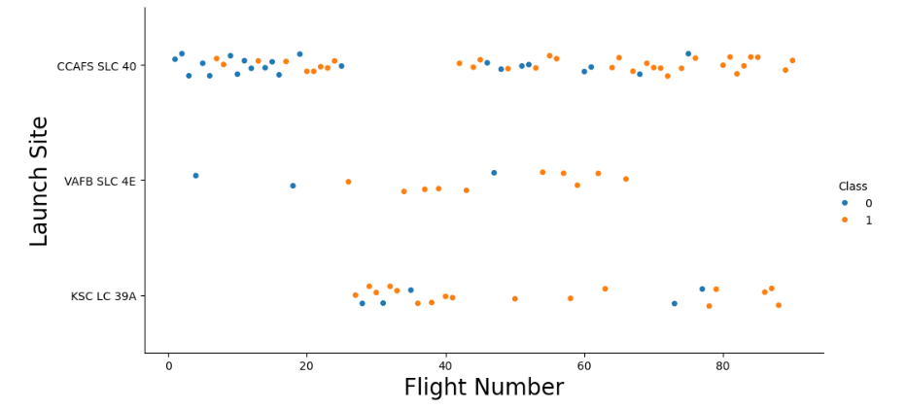
Flight Number vs. Launch Site
CCAFS SLC 40 improvement: Early flights show mostly failed landings (class 0), but success rates improve significantly in later flight numbers, indicating learning curve effects.
KSC LC 39A high success: This site shows predominantly successful landings (class 1) and is used mainly for later flights, suggesting it's reserved for missions with proven landing technology.
VAFB SLC 4E mixed performance: This site shows varied success rates throughout the flight sequence, possibly due to the challenging nature of polar/sun-synchronous orbit missions that typically launch from this location.

Slide 19
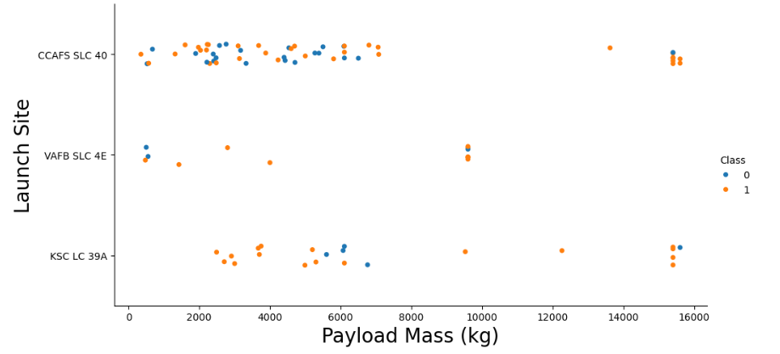
Payload vs. Launch Site
For the VAFB-SLC launchsite there are no rockets launched for heavypayload mass(greater than 10000).

Slide 20
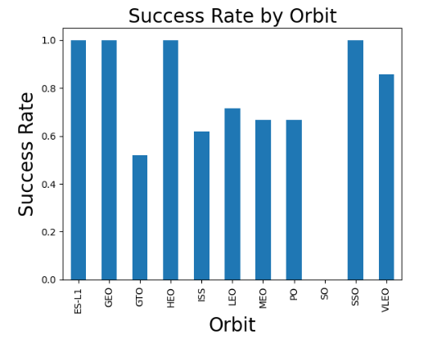
Success Rate vs. Orbit Type
Perfect success orbits: ES-L1, GEO, HEO, and SSO missions achieve 100% landing success rates, indicating these orbit types are most compatible with successful booster recovery.
Challenging orbit identified: GTO missions show the lowest success rate (~52%), suggesting geostationary transfer orbits require more fuel, leaving less margin for successful landing burns.
Performance variation: Success rates vary significantly across orbit types (52%-100%), demonstrating that mission trajectory and fuel requirements directly impact landing feasibility.

Slide 21
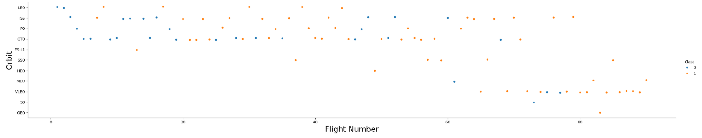
Flight Number vs. Orbit Type
In the LEO orbit, success seems to be related to the number of flights. Conversely, in the GTO orbit, there appears to be no relationship between flight number and success.

Slide 22
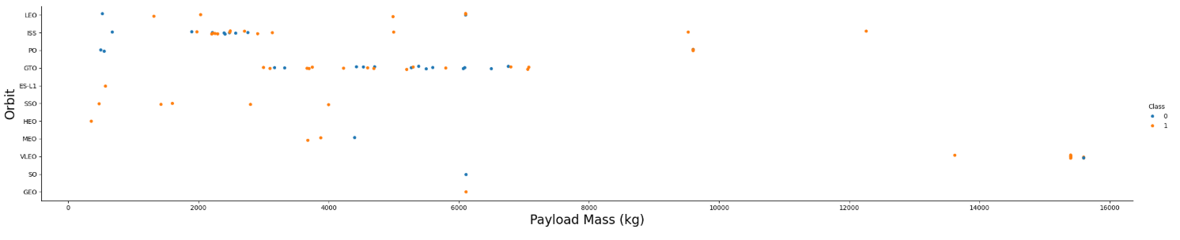
Payload vs. Orbit Type
With heavy payloads the successful landing or positive landing rate are more for Polar,LEO and ISS.
However, for GTO, it's difficult to distinguish between successful and unsuccessful landings as both outcomes are present.

Slide 23
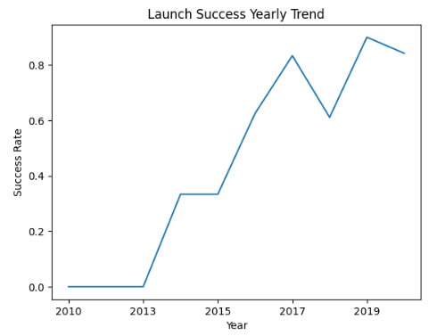
Launch Success Yearly Trend
Success rate since 2013 kept increasing till 2020

Slide 24
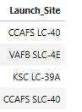
All Launch Site Names
Names of the unique launch sites in the space mission
%sql SELECT DISTINCT "Launch_Site" FROM SPACEXTABLE;

Slide 25
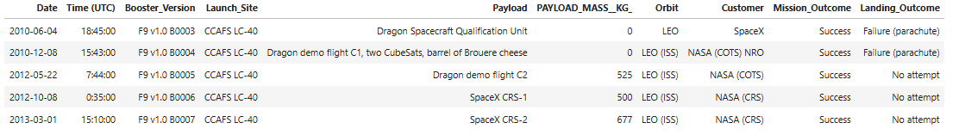
Launch Site Names Begin with 'CCA'
5 records where launch sites begin with `CCA`
%sql SELECT * FROM SPACEXTABLE WHERE "Launch_Site" LIKE 'CCA%' LIMIT 5;

Slide 26
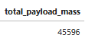
Total Payload Mass
Total payload mass carried by boosters launched by NASA (CRS)
%sql SELECT SUM("Payload_Mass__kg_") AS total_payload_mass FROM SPACEXTABLE WHERE "Customer" = 'NASA (CRS)';

Slide 27
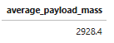
Average Payload Mass by F9 v1.1
Average payload mass carried by booster version F9 v1.1
%sql SELECT AVG("Payload_Mass__kg_") AS average_payload_mass FROM SPACEXTABLE WHERE "Booster_Version" = 'F9 v1.1’;

Slide 28
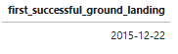
First Successful Ground Landing Date
Date of the first successful landing outcome on ground pad
%sql SELECT MIN("Date") AS first_successful_ground_landing FROM SPACEXTABLE WHERE "Landing_Outcome" LIKE '%ground pad%' AND "Landing_Outcome" LIKE '%Success%’;

Slide 29
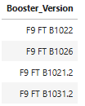
Successful Drone Ship Landing with Payload between 4000 and 6000
Names of boosters which have successfully landed on drone ship and had payload mass greater than 4000 but less than 6000
%sql SELECT DISTINCT "Booster_Version" FROM SPACEXTABLE WHERE "Landing_Outcome" LIKE '%drone ship%' AND "Landing_Outcome" LIKE '%Success%' AND "Payload_Mass__kg_" > 4000 AND "Payload_Mass__kg_" < 6000;

Slide 30
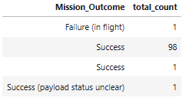
Total Number of Successful and Failure Mission Outcomes
Total number of successful and failure mission outcomes
%sql SELECT "Mission_Outcome", COUNT(*) AS total_count FROM SPACEXTABLE GROUP BY "Mission_Outcome"; short explanation here

Slide 31
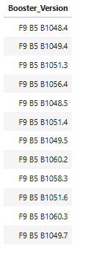
Boosters Carried Maximum Payload
Names of the booster which have carried the maximum payload mass
%sql SELECT DISTINCT "Booster_Version" FROM SPACEXTABLE WHERE "Payload_Mass__kg_" = (SELECT MAX("Payload_Mass__kg_") FROM SPACEXTABLE);

Slide 32
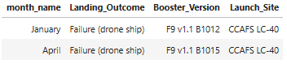
2015 Launch Records
Failed landing_outcomes in drone ship, their booster versions, and launch site names for in year 2015
%sql SELECT CASE substr("Date", 6, 2) WHEN '01' THEN 'January' WHEN '02' THEN 'February' WHEN '03' THEN 'March' WHEN '04' THEN 'April' WHEN '05' THEN 'May' WHEN '06' THEN 'June' WHEN '07' THEN 'July' WHEN '08' THEN 'August' WHEN '09' THEN 'September' WHEN '10' THEN 'October' WHEN '11' THEN 'November' WHEN '12' THEN 'December' END AS month_name, "Landing_Outcome", "Booster_Version", "Launch_Site" FROM SPACEXTABLE WHERE "Landing_Outcome" LIKE '%drone ship%' AND "Landing_Outcome" LIKE '%Failure%' AND substr("Date", 0, 5) = '2015';

Slide 33
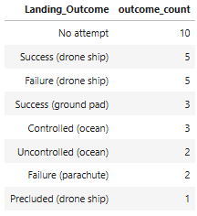
Rank Landing Outcomes Between 2010-06-04 and 2017-03-20
Rank the count of landing outcomes (such as Failure (drone ship) or Success (ground pad)) between the date 2010-06-04 and 2017-03-20, in descending order
%sql SELECT "Landing_Outcome", COUNT(*) AS outcome_count FROM SPACEXTABLE WHERE "Date" BETWEEN '2010-06-04' AND '2017-03-20' GROUP BY "Landing_Outcome" ORDER BY COUNT(*) DESC;

Slide 34

Section 3

Slide 35
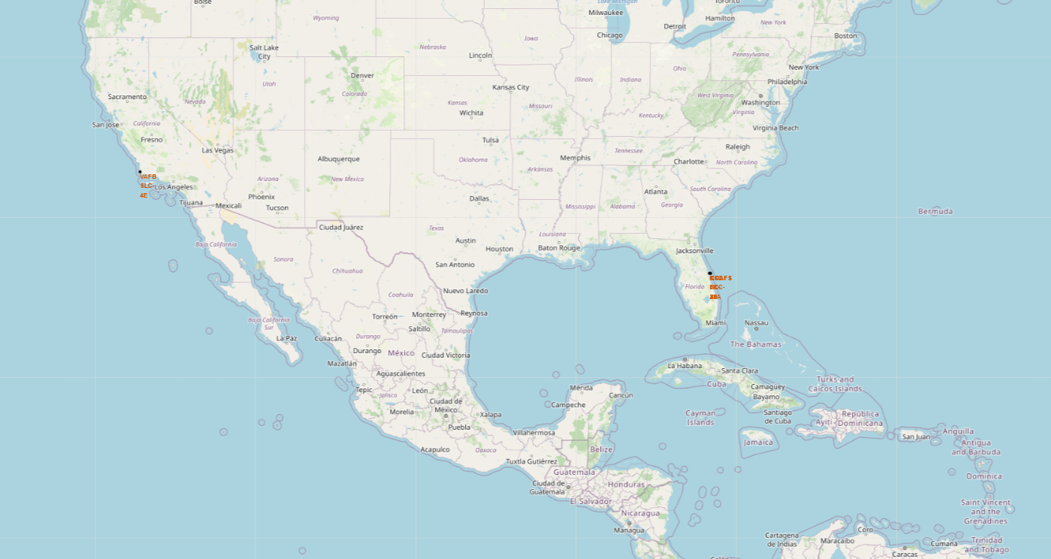
Map with Marked Launch Sites
Not all launch sites are in proximity to the Equator. The launch site in California is located much farther north.
All the launch sites shown on the map are in very close proximity to the coast.

Slide 36
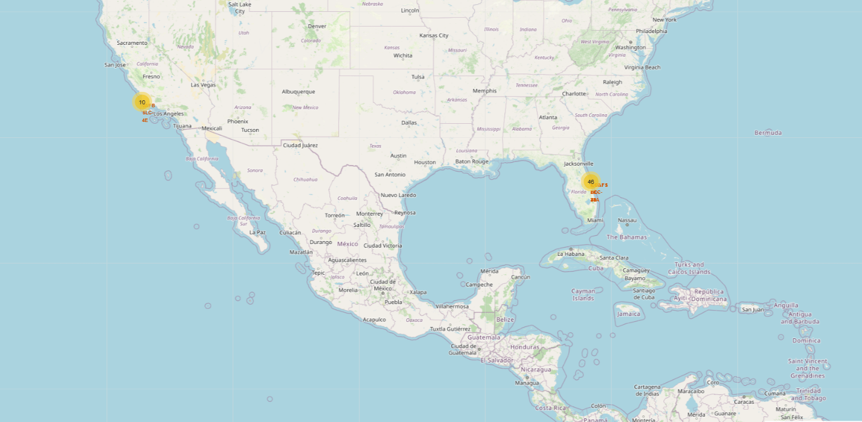
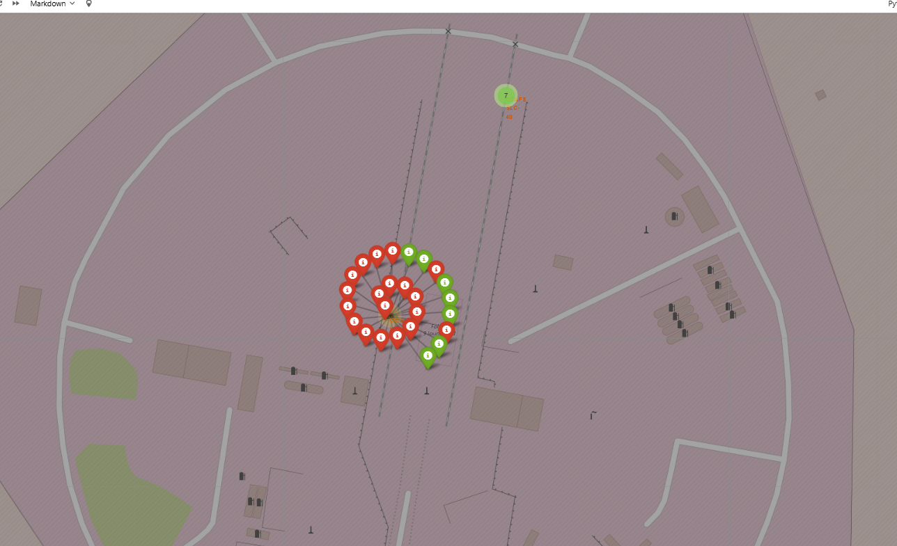
Map with Color-labeled Launch Outcomes
From the color-labeled markers in marker clusters, you should be able to easily identify which launch sites have relatively high success rates.

Slide 37
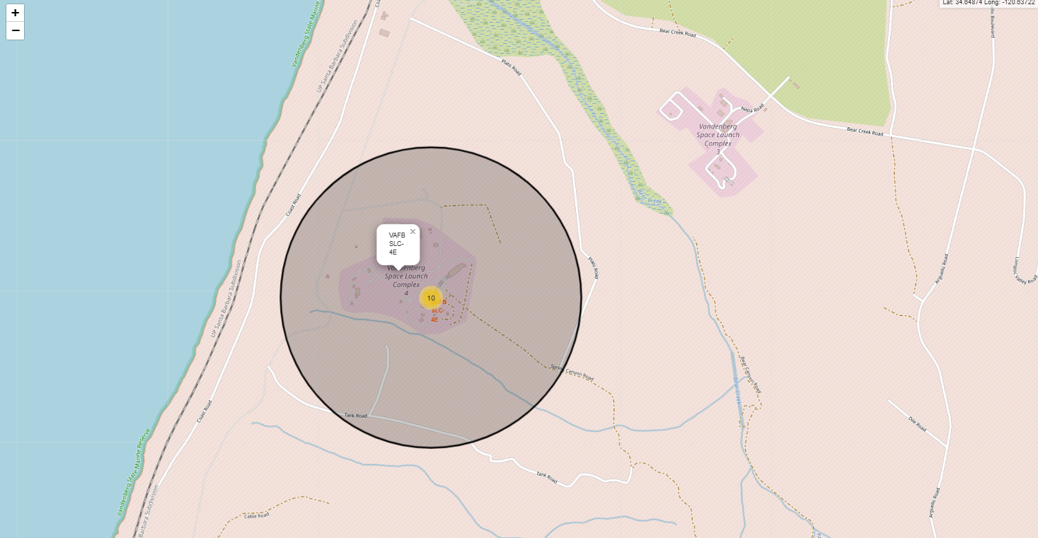
Map of a Launch Site
Launch sites are not necessarily in close proximity to railways.
Launch sites are in close proximity to highways.
Launch sites are in close proximity to coastline.
Launch sites keep a certain distance away from cities. This is primarily for safety reasons, ensuring that if a launch fails, debris falls into a less populated area.

Slide 38

Section 4

Slide 39
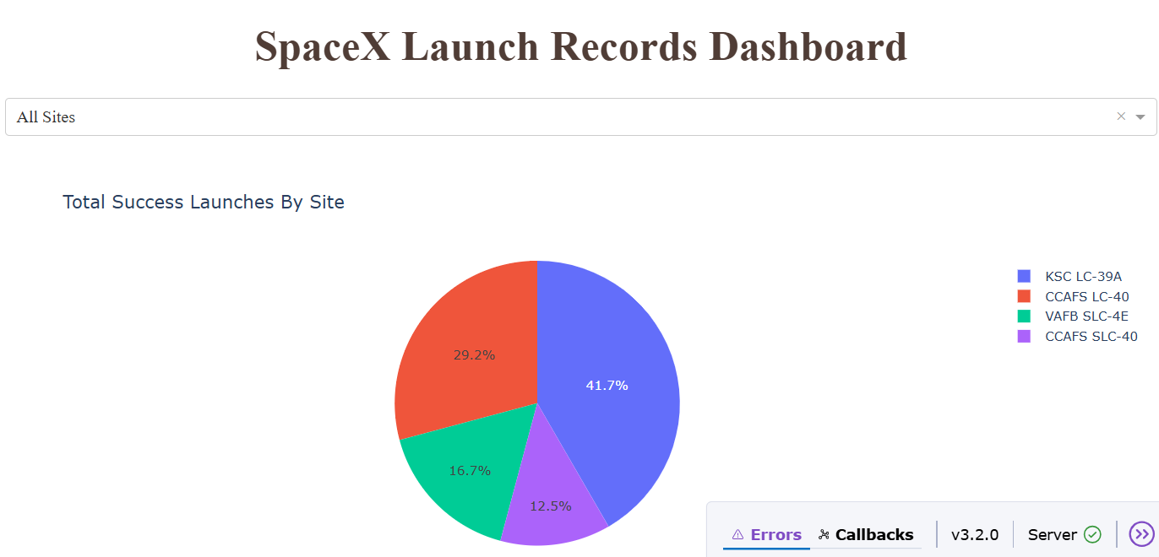
Launch Success Count for All Sites
KSC LC-39A dominates with 41.7% of launches, followed by CCAFS LC-40 at 29.2%
East Coast sites (KSC and CCAFS) handle ~71% of all successful launches, with West Coast VAFB at 16.7%

Slide 40
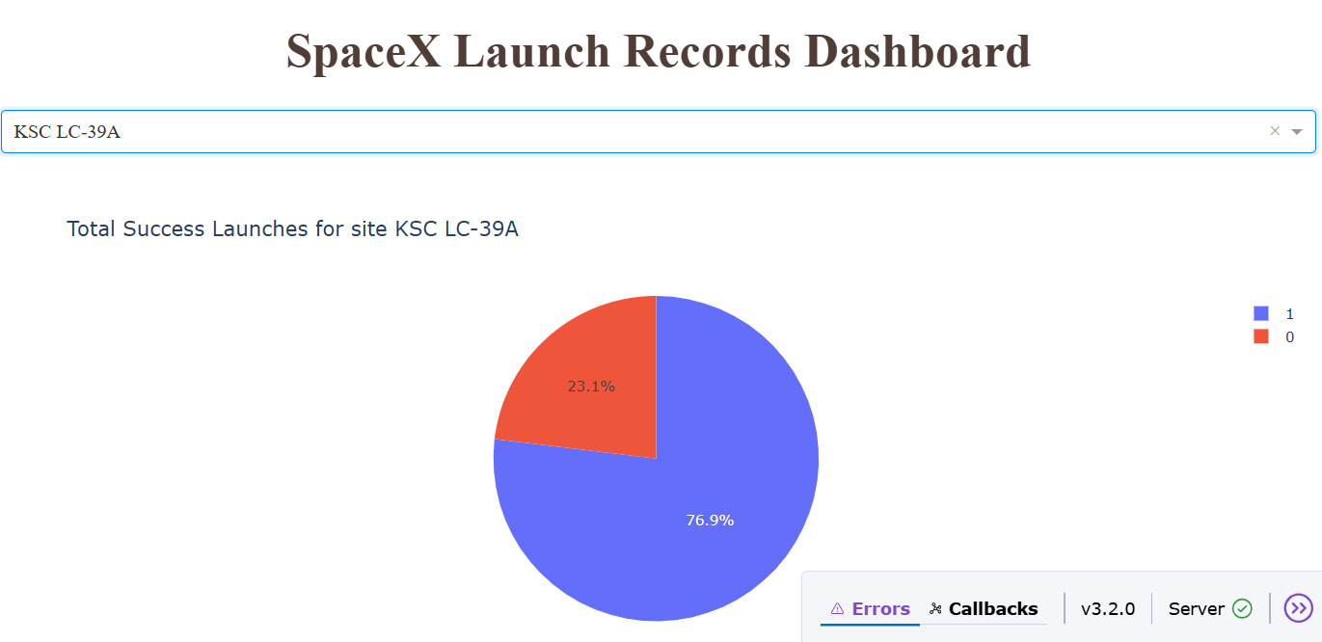
Total Success Launches for site KSC LC-39A
KSC LC-39A has a 76.9% success rate (blue) versus 23.1% failure rate (red orange)

Slide 41
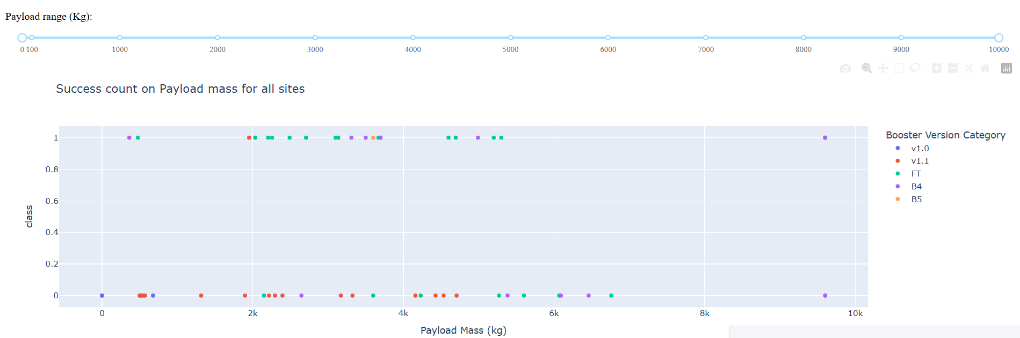
Success Count on Payload Mass for All Sites
Most successful launches (class=1) are concentrated in the 2k-6k kg payload range across all booster types
Failures (class=0) occur primarily in lighter payloads under 4k kg, with older booster versions (v1.0, v1.1, FT) showing more failures than newer ones (B4, B5)

Slide 42

Section 5

Slide 43
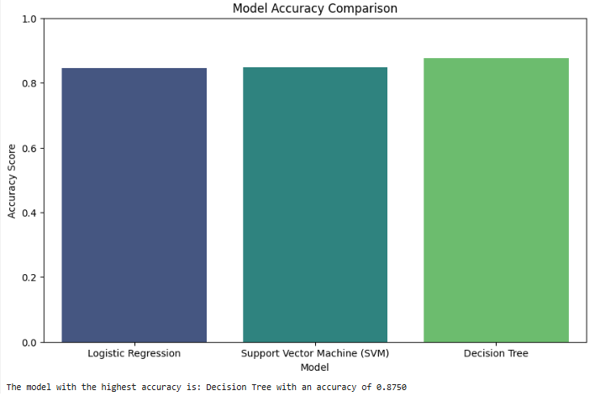
Classification Accuracy
The model with the highest accuracy is Decision Tree with an accuracy of 0.8750

Slide 44
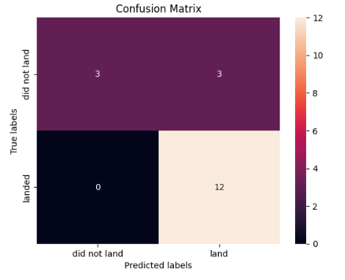
Confusion Matrix
The confusion matrix showed the Decision Tree model correctly identified 12 successful landings and 3 unsuccessful landings, with 3 false positives and 0 false negatives.

Slide 45
Conclusions
The project successfully developed a predictive model, and exploratory data analysis revealed a clear correlation between landing success and factors like payload mass and launch site.
Landing success rates have improved over time, indicating the company's technological refinement and increased experience.
The K-Nearest Neighbors model was identified as the best-performing algorithm, proving more effective than other evaluated models.
An interactive Dash dashboard was created to serve as a powerful tool for visualizing the data and providing valuable insights for future missions.
Overall, this data-driven approach demonstrates a reliable method for predicting Falcon 9 first-stage landing success and understanding its key contributing factors.

Slide 46


